Slide 1
Waste management in Montenegro
1. PROBLEM STATEMENT
2. EXISTING SOLUTIONS
3. THE PROPOSED SOLUTION AND ITS ESSENCE
4. WHAT WILL BE DONE TO DEMONSTRATE THAT IT IS BETTER,
UNDER WHAT CONDITIONS,
FOR HOW MUCH, BOTH IN ECONOMY AND IN OTHER EFFECTS.

Slide 2

1. PROBLEM STATEMENT
Reports on waste management in Montenegro record negative results.
According to the Montenegrin Law on Waste Management,
50% of paper, metals, plastics and glass were to be recycled by 2025,
but last year’s estimate was only 1,17%.
Such data cause far-reaching consequences for the whole environment.
Itʾs mostly non-degradable waste, and thus this problem gained new dimensions over time.

Slide 3
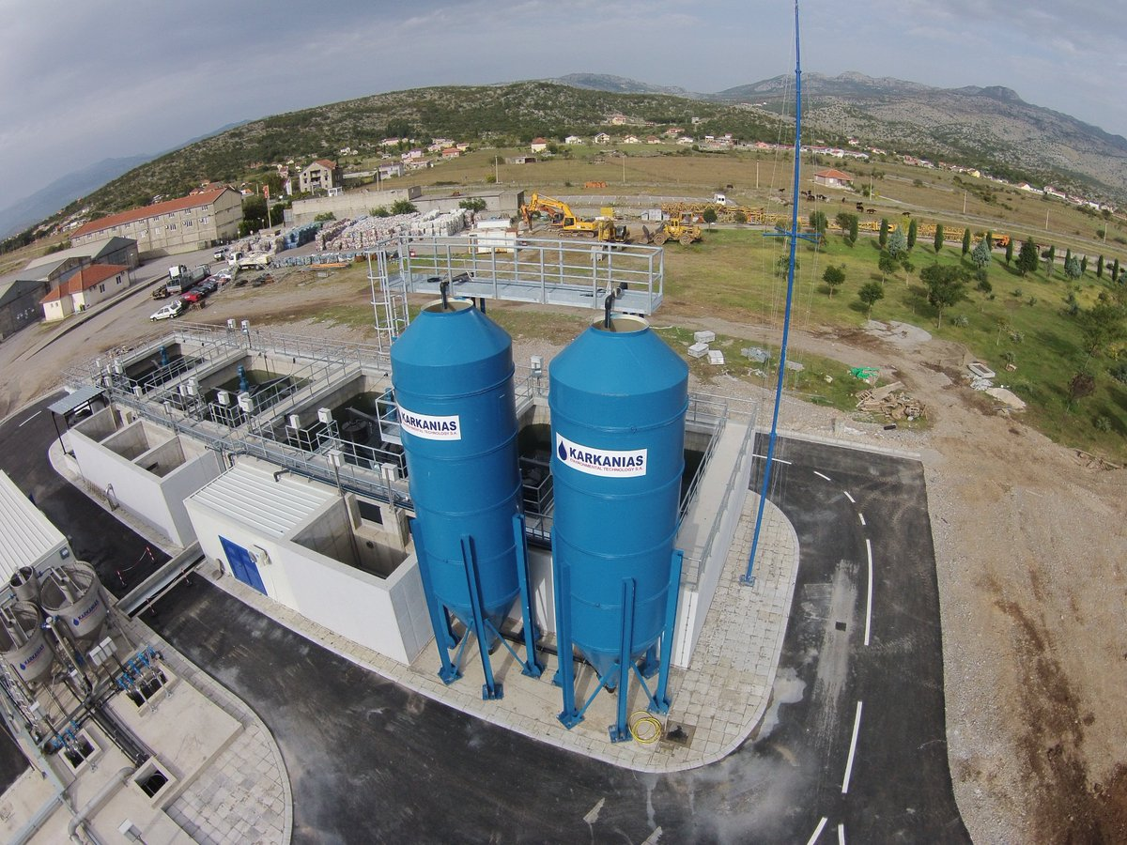
2. EXISTING SOLUTIONS
The Montenegrin Government is strongly committed to the EU integration process.
Chapter 27 is one of the most demanding and expensive for implementation.
There are 9 recycling yards and 2 sanitary landfills in the country.
The Government has announced the construction of 4 Waste Management Centers,
and the existence of a waste treatment center.
However, the results showed that this was insufficient because:
  Resources are scarce.
  Coordination between environmental institutions is insufficient.
  Strategic planning and financing is poor.
  Awareness of the importance of selective waste disposal and recycling is inadequat.

Slide 4

3. THE PROPOSED SOLUTION
Shape the environmental awareness and habits of children ages 6-14 through education.
Make an impact on the awareness and habits of the parents through students,
further on the wider community.
Integrate waste selection as a regular activity of every primary school
(with the support of the Landfill infrastructure).
Help the school by joining forces
through a constant inflow of profits from the collected waste.

Slide 5

4. WHAT WILL BE DONE TO DEMONSTRATE THAT IT IS BETTER,
UNDER WHAT CONDITIONS,
FOR HOW MUCH, BOTH IN ECONOMY AND IN OTHER EFFECTS
We will achieve a far-reaching effect in a cheap and efficient way.
The condition for successful action is the support of the Landfill,
which will provide 4 waste separation containers and 2 waste trucks.
The result will be measurable through:
Number of students who bring separated waste to school.
Number of households outside the school that separate and hand over waste to us.
Amount of waste collected.
Amount of money the school earned from waste.
Number of teaching aids that the school bought that the state could not provide.

Slide 6

“A young soul is like soft wax.
What kind of mold you put it in,
you get a man like that from her.”
Dositej Obradovic

